Slide 1




Insights Hub For Testing Metrics (AI- Enabled Testing Metrics Dashboard)
Team members:- Aditya Kupparavalli Madhusudana Hari Krishna Balamurali Ullas Krishna Sai Siddaraju Poojitha Soumya Muddam
March 2025

Slide 2

Executive Summary
The AI-Enabled Testing Metrics Dashboard is a centralized analytics solution designed to streamline project oversight by providing end-to-end visibility into requirement traceability, defect trends, and testing performance.
Developed using Power BI, SQL, and Excel, the dashboard equips project managers, QA leads, and stakeholders with real-time insights to proactively monitor progress, identify bottlenecks, and make data-driven decisions.
With built-in AI capabilities such as natural language Q&A, it transforms static reporting into an interactive, decision-support system—enhancing collaboration, accelerating response times, and improving overall delivery quality across the software development lifecycle.

Slide 3

Problem Statement:- In today’s rapidly evolving and distributed software development environments, maintaining clear traceability between business requirements, test cases, and defect outcomes remains a persistent challenge. Testing data is often scattered across disconnected tools, resulting in fragmented visibility, particularly for leadership teams responsible for quality oversight and strategic decision-making. This lack of centralized insight creates several critical issues: - Difficulty in validating whether all business requirements are adequately tested - Delays in detecting and resolving high-impact defects - Inability to monitor project quality in real-time - Increased risk of delivery failures and erosion of stakeholder confidence - Without a unified view of testing progress and defect health, teams struggle to stay aligned, make timely interventions, or present reliable data during reviews and client meetings.

Slide 4

Our Solution:
To address these challenges, we developed an AI-Enabled Testing Metrics Dashboard
a consolidated, intelligent platform built using Power BI, SQL, and Excel.
This dashboard integrates multiple testing dimensions into a single interactive
interface, providing comprehensive insights across:
Requirement traceability (from program-level initiatives to individual test cases and defects)
Defect analytics, including key KPIs such as resolution rates, leakage, and defect aging
Testing progress summaries, supported by automation coverage and task-level metrics
By incorporating AI capabilities such as natural language Q&A and cognitive services, the solution allows both technical and Non-technical stakeholders to interact with the data intuitively, ask contextual questions, and receive real-time answers.
The outcome: enhanced visibility, faster decision-making, improved quality governance, and the ability to deliver confidently across internal and client-facing engagements.

Slide 5

Implementation Phases 1. Planning & Requirement Gathering Defined key KPIs, stakeholder needs, and dashboard goals 2. Data Collection & Mock Preparation Simulated real-world test data using Excel & SQL; modeled key relationships (Epics → Defects) 3. Wireframing & Design Sketched dashboard structure; prioritized usability and drill-down interactivity 4. Power BI Development Built data model, visuals, and navigation; applied DAX measures and filters 5. KPI & AI Integration Added performance metrics, defect calculations, and AI Q&A (Test Genie)

Slide 6
Data Model- Foundation of Dashboard - Built on five key tables: Epic → Feature → User Stories → Tasks → Defects - Structured with 1:Many relationships to enable accurate drill-downs and filtering - Captures end-to-end traceability across testing activities - Supports KPIs like Defect Leakage, MTTR, and Automation Coverage - Powers all dashboard interactions and filters - Ensures consistency across Traceability Matrix and KPI visuals

Slide 7

Dashboard 1 – Requirements Traceability Matrix - Tracks hierarchy: Program → Project → Epic → Feature → User Story → Task → Defect - Uses color-coded indicators for quick status recognition: 🟩 Green = Complete 🟨 Yellow = In Progress 🟥 Red = At Risk 🟦 Blue = New / Unassigned. - Drill-down enabled for deep traceability - Filters help Project Managers focus on specific Epics or bottlenecks - Instantly flags gaps, delays, or unassigned ownership

Slide 8
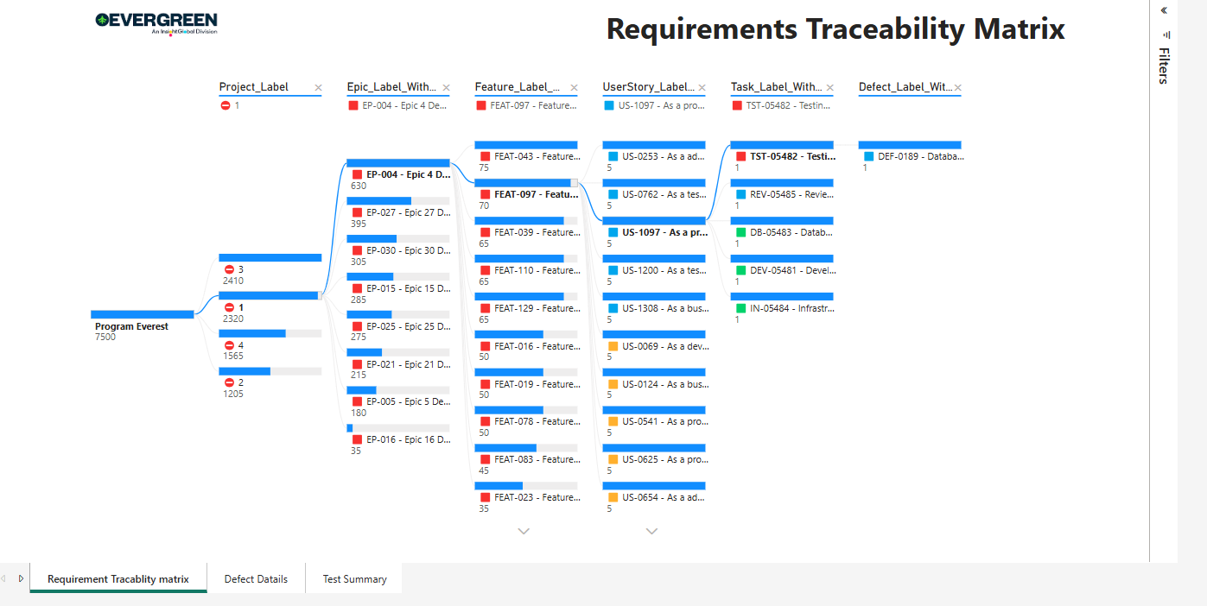
Requirements Traceability Matrix Dashboard

Slide 9


Dashboard 2 – Defects Overview A centralized view to monitor defect health, trends, and resolution effectiveness. Tracks key metrics of Defects Visual breakdowns by: - Status, Severity, Environment, and Age Buckets - Designed for QA leads and test managers to monitor trends and identify hot spots - Filters and slicers enable in-depth analysis across time periods and categories

Slide 10
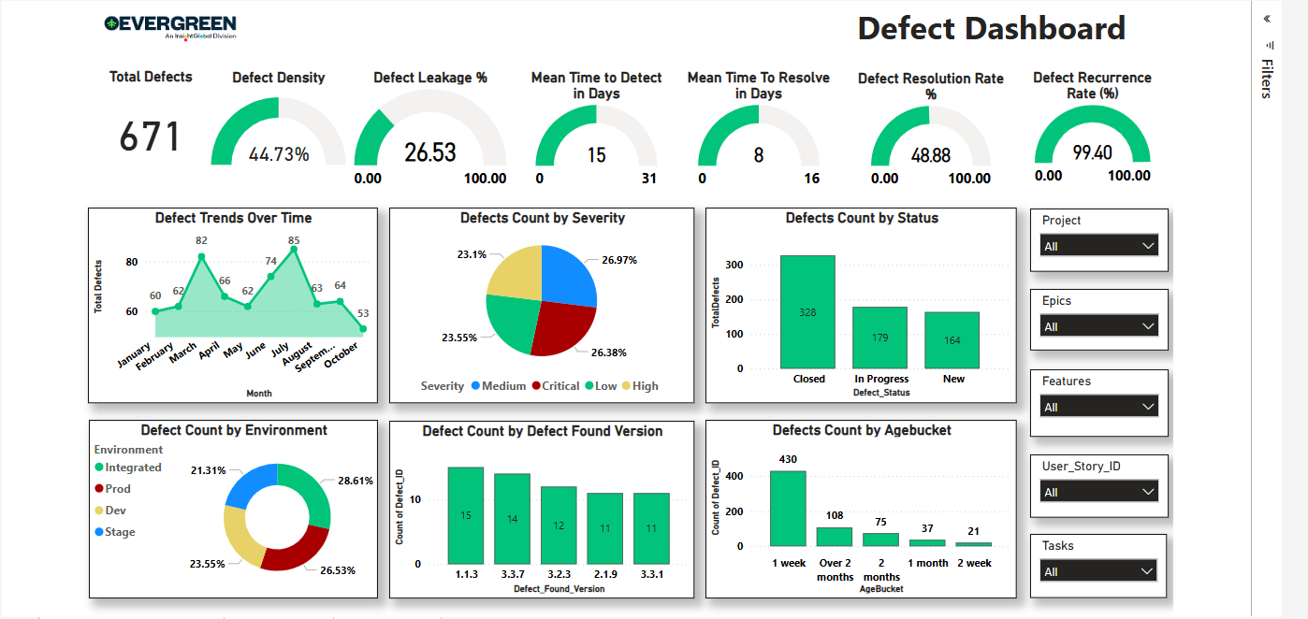
Defects Dashboard

Slide 11
Defects KPIs – Interpreting Quality Trends These KPIs provide a 360° view of testing effectiveness, defect behavior, and team responsiveness. 🧾 Total Defects – Shows overall defect volume across all statuses 📊 Defect Density – Measures defect concentration per feature or user story 🚨 Defect Leakage % – Highlights issues that escaped into production ⏱️ Mean Time to Detect (MTTD) – Time taken to uncover a defect 🛠️ Mean Time to Resolve (MTTR) – Time taken to fix and close a defect ✅ Defect Resolution Rate % – Percentage of defects successfully resolved 🔁 Defect Recurrence Rate % – Tracks reopened or recurring issues 🔎 Interactive Filters – Slice data by project, epic, environment, or age to identify root causes quickly 🎯 How it helps: Empowers QA teams and managers to drill down on specific segments, prioritize critical issues, and drive informed discussions in reviews.

Slide 12

Dashboard 3 – Test Summary Dashboard The Test Summary Dashboard delivers a comprehensive view of testing progress, resource allocation, and automation adoption across the project lifecycle. 🔄 Combines both manual and automated testing insights 📦 Tracks the volume of Epics, Features, User Stories, Tasks, and Defects 🎯 Highlights overall test health and potential bottlenecks (e.g., blocked features) ⚙️ Integrates with AI-powered Q&A (Test Genie) for real-time answers 🧭 Empowers managers to quickly assess execution status and coverage 🧠 Purpose: To provide a high-level snapshot of where the project stands in terms of testing, what's automated, what's blocked, and how effectively defects are being caught.

Slide 13
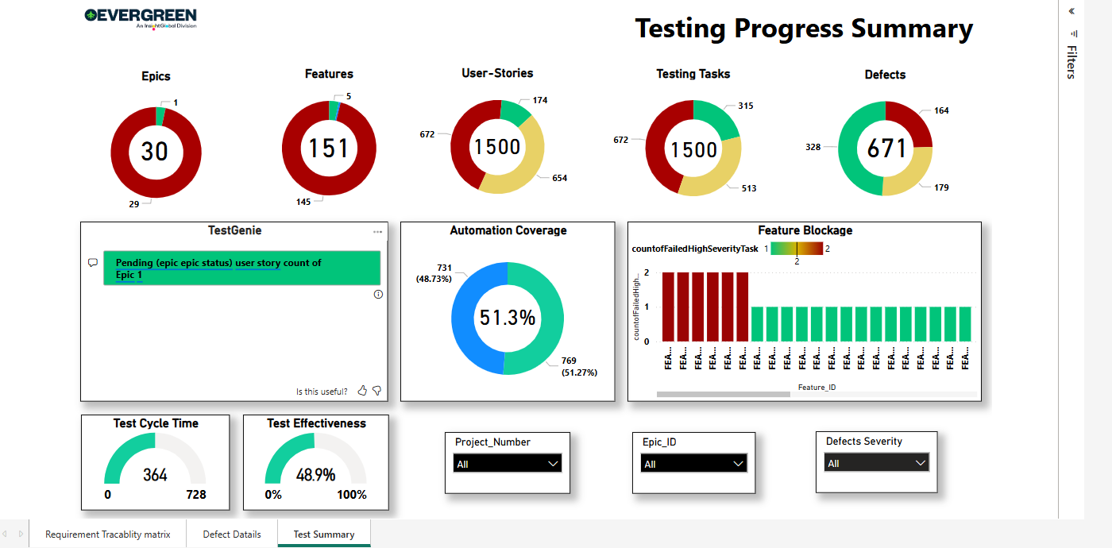
Test Summary Dashboard

Slide 14
Test Summary KPIs – Driving Test Visibility These KPIs provide key insights into testing velocity, effectiveness, and automation maturity. 🧪 Test Cycle Time – Total duration of a test cycle; helps assess testing speed and delays 🎯 Test Effectiveness – % of test cases that led to defect identification; measures test case quality 🤖 Automation Coverage – Balance between automated vs manual test execution 🧱 Entity Distribution – Live count of Epics, Features, User Stories, Tasks, and Defects 🟥 Feature Blockage – Identifies high-severity issues that are blocking feature progression 💬 TestGenie (Q&A Tool) – AI-powered assistant to answer queries like “Pending stories in Epic 4” 🎯 Why it matters: These KPIs help QA and project managers prioritize tasks, resolve blockers, and communicate progress efficiently in reviews and stand-ups.

Slide 15

AI Assistant – Test Genie An embedded natural language Q&A tool for instant insights without manual filtering. 💬 Ask real-time questions like: “Count of pending defects in Epic EP-004” “Which features are blocked due to high-severity tasks?” 🧠 Powered by Power BI’s Q&A integration 🧩 Useful in client reviews, sprint retrospectives, or leadership updates 📉 Saves manual effort and speeds up investigations

Slide 16
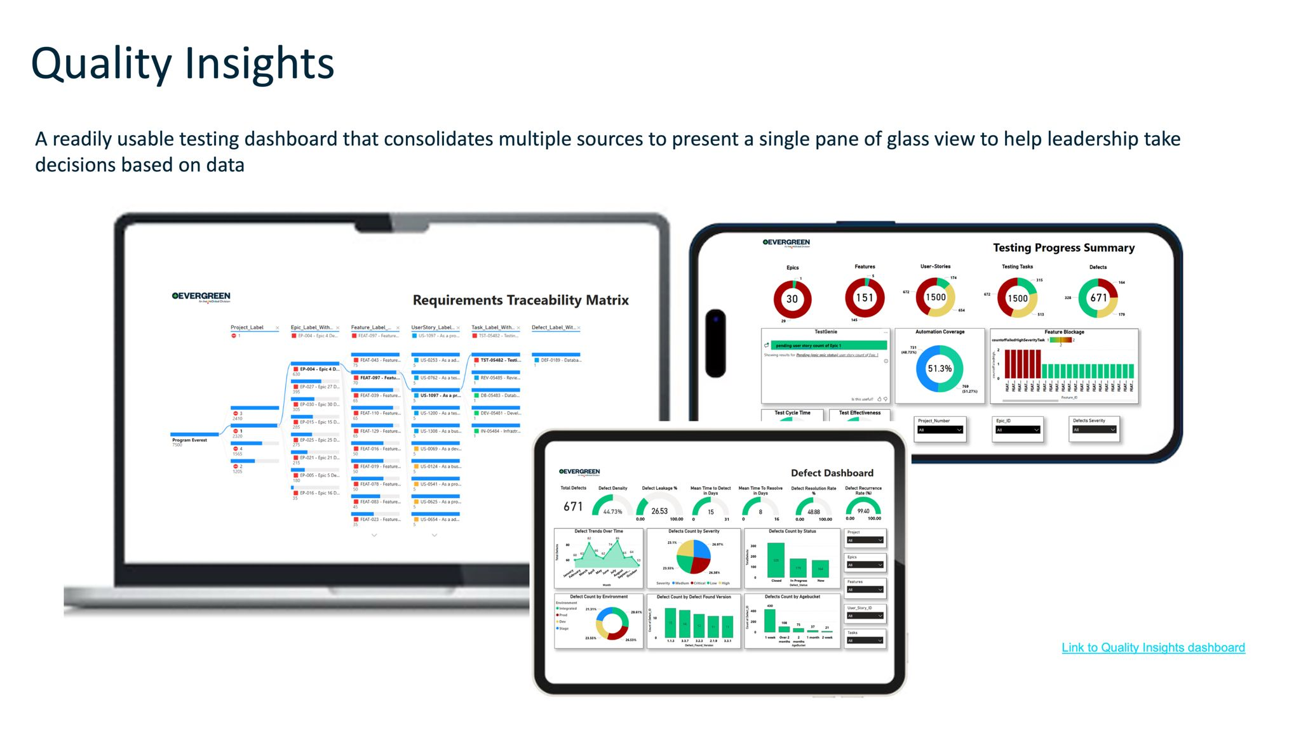

Slide 17

Conclusion - Provides a centralized view of the entire testing lifecycle - Empowers real-time decision-making through actionable metrics - Built as an extensible platform with AI integration capabilities - Supports daily collaboration and executive-level reporting - Enables faster delivery, improved visibility, and data-driven outcomes “Our dashboard bridges the gap between testing operations and strategic insight”.

Slide 18
Thank you!
Special Thanks To:
Raja – For sponsoring and guiding us throughout the project
Ramesh – For his valuable collaboration and continuous support

